Slide 1
SMART FARMING USING IOT
REVIEW-III
Presenting by:
Y Mohan Sai Reddy
C Sai Dileep
D Babji
R VenkataSurendra Reddy

Slide 2
ABSTRACT
The main aim of this project is that making the farmers to aware of the temperature and moisture to control the crop growth using IoT.The new developments of Smart Farming with use of IoT, by day turning the face of conventional agriculture methods by not only making it optimal but also making it cost efficient for farmers and reducing crop wastage. The aim is to propose a technology which can generate messages on different platforms to notify farmers. The product will assist farmers by getting live data (Temperature, humidity, soil moisture) from the farmland to take necessary steps to enable them to do smart farming by also increasing their crop yields and saving resources like water. In this project we usedESP32s Node MCU, breadboard, DHT11 Temperature and Humidity Sensor, Soil Moisture Sensor, Jumper wires and live data feed can be monitored on serial monitor and Blynk mobile. This will allow farmer to manage their crop with new age in farming.

Slide 3
INTRODUCTION
Smart farming, also known as precision agriculture, leverages advanced technologies such as the Internet of Things (IoT) to enhance agricultural practices and improve overall efficiency. One crucial aspect of smart farming is the implementation of IoT in managing irrigation and temperature control. This integration enables farmers to make data-driven decisions, optimize resource usage, and ultimately increase crop yields while conserving resources.
Smart farming involves the use of various technologies to collect and analyze real-time data from the field. IoT plays a pivotal role in this process by connecting sensors, actuators, and other devices to a centralized system. These devices gather data on soil moisture levels, weather conditions, crop health, and more, providing farmers with valuable insights into the state of their fields.

Slide 4
PROPOSED SYSTEM
Proposed system consists of a Moisture based irrigation system and the temperature control system using temperature sensor.
Our project collects the realtime data from temperature sensor and stores the data in csv format which will helps in determinging the temperatures of a specific time using machine learning algorithms.
The proposed system will protects the crop by covering the filed with thin layer of sheet when the temperature reaches the threshold limit.

Slide 5
TOOLS & TECHNIQUES
1.Arduino Uno R3
2.Temparature &Humidity Sensor.
3.ESP23 Node MCU
4.Moisture Sensor
5.Blynk Iot App
6.Bread Board.
7.DC Motors.

Slide 6
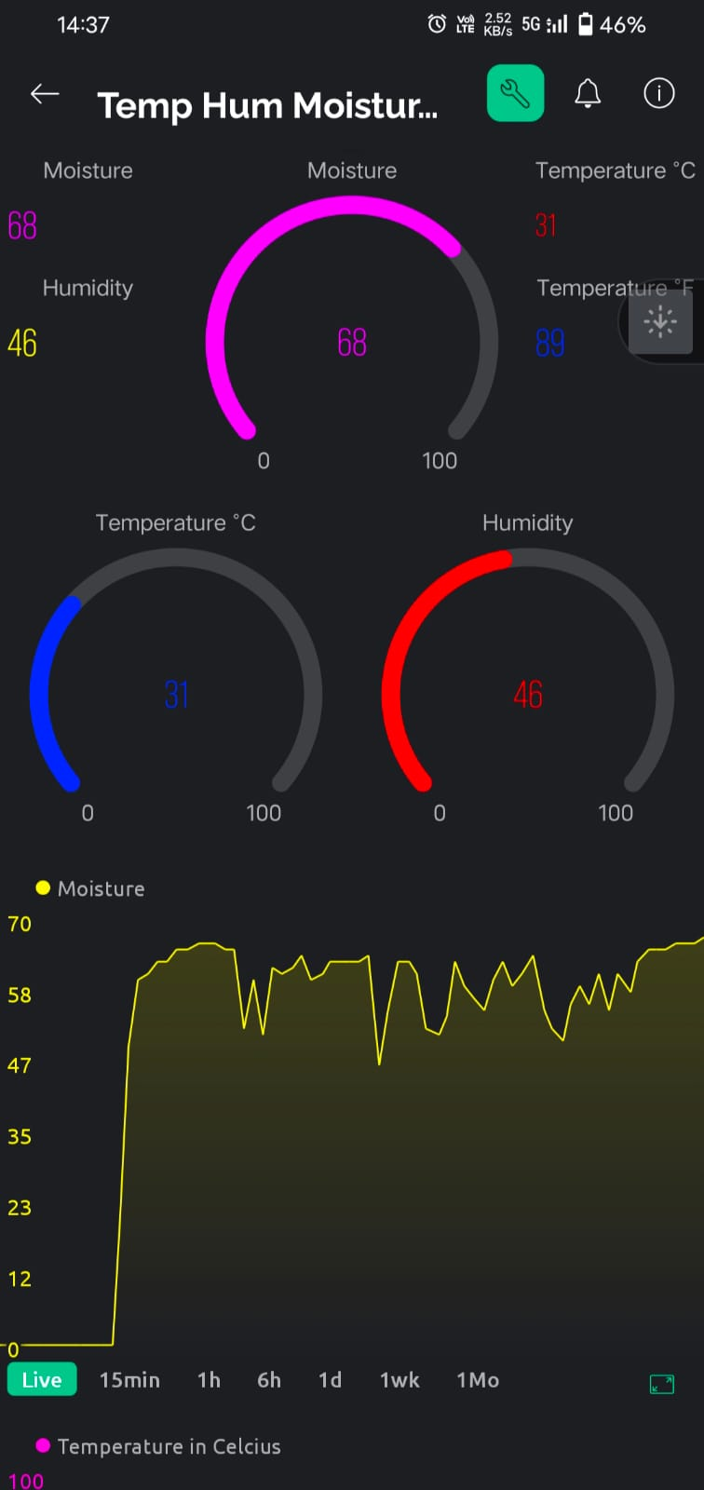
BLYNK IOT APPLICATION INTERFACE
The BLYNK Iot Application will provides an interface and Interaction between the ESP328p To monitor the data coming from the Differnet sensors connect to the ESP328p Wifi board.
It will be used to control the devices connected to the Arduino Uno manually whenever required.
Blynk Iot Application will also provide data visualization interface using line graphs,bar graphs etc.

Slide 7
Live Monitoring & Visualization
Live monitoring of temperature, humidity, and moisture can be achieved using an ESP8266 microcontroller connected to Blynk, enabling real-time data visualization and remote access for environmental tracking and control.
Using an ESP8266 microcontroller and Blynk platform, real-time monitoring of temperature, humidity, and moisture levels becomes accessible through a seamless integration, providing comprehensive environmental data for informed decision-making and remote management of indoor or outdoor spaces.

Slide 8
Instant Alerting System
By integrating NodeMCU ESP8266 with the Blynk app, instant alerts for temperature, humidity, and moisture levels can be set up to trigger SMS notifications and email alerts. Utilizing Blynk's functionality, thresholds for each parameter can be defined, and when these thresholds are exceeded, Blynk will send notifications to configured phone numbers and email addresses, ensuring timely updates on environmental conditions for proactive intervention or monitoring purposes.
Additionally, NodeMCU ESP8266's connectivity allows for seamless communication with the Blynk cloud server, enabling reliable and efficient transmission of data and alerts, thereby enhancing the monitoring and management of environmental parameters in various settings.

Slide 9
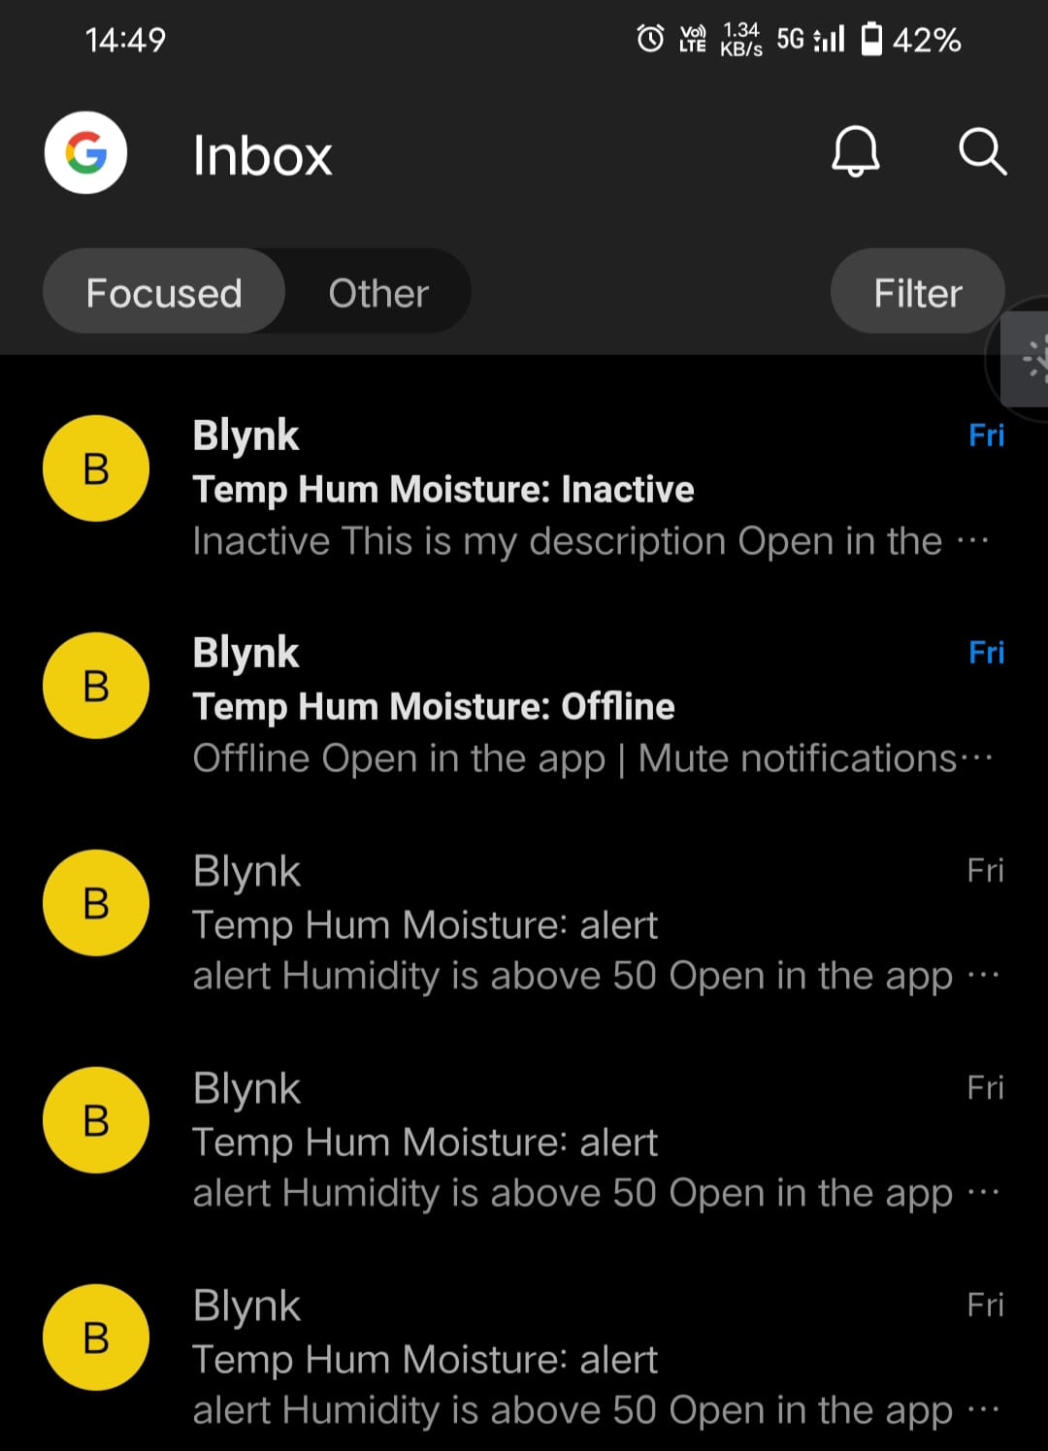
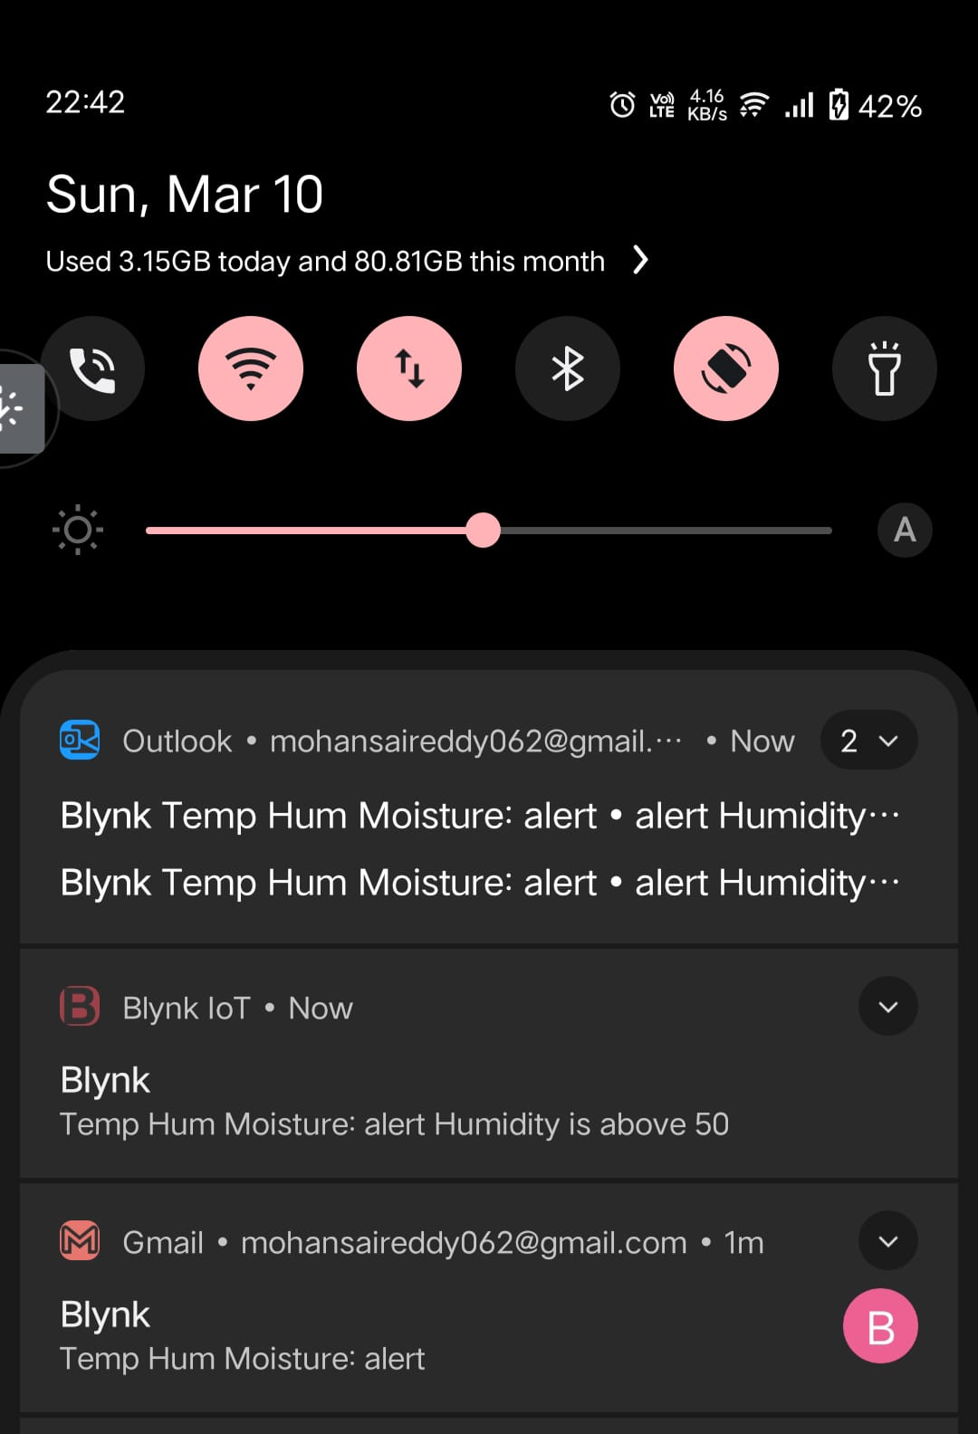

Slide 10
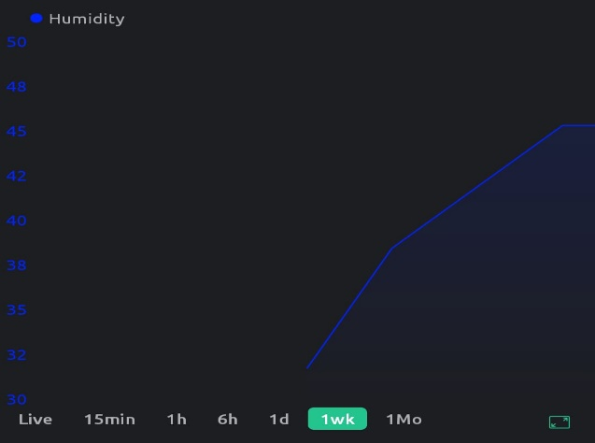

Slide 11
